Slide 1
Algorithmics
Welcome to the
class of 2021
Also known (by some) as:
“That Cool Problem Solving Class”
“The Masters of the Universe”
“That awesome group of legends who are really smart”
“The First Order”

Slide 2

Algorithmics (HESS)
Congratulations on choosing to do (or being forced to do) the most interesting subject in the VCE curriculum design.
Algorithmics is the only Higher Education Scored Study (HESS) subject the VCE offers. HESS subjects can count in your top 4 subjects but also have the added benefit in that Monash and Melbourne University both agree to grant credit towards a student’s first year of studies in a related field (computer science) to students who have completed the subject.

Slide 3

Algorithmics (HESS)
But you’re probably curious about the course and what you will actually learn about and do. So let’s take a look.
Unit 3
Data Modelling with abstract data types
Algorithm design
Applied algorithms
Unit 4
Formal algorithm analysis
Advanced algorithm design
Universality of computation and algorithms

Slide 4
Algorithmics (HESS)
There will be no SACs in Algorithmics… There will, however, be SATs (School Assessed Tasks). SATs will be project based. It’s a bit like a folio of work that you will complete over the semester.
These tasks are assessed against a rubric and while, you will still do some tests and get scores for the tests, these scores will be split and distributed among the relevant rubric.
Basically, if you want to do well in algorithmics, do all the work and hand it in on time. Even if you can’t get to the final solution, submit what you’ve done.
THE PROCESS IS MORE IMPORTANT THAN THE RESULT

Slide 5
Algorithmics (HESS)
The rubric:
https://www.vcaa.vic.edu.au/Documents/vce/adjustedSD2020/2020VCEAlgorithmicsSBAAdminAdjusted.pdf

Slide 6
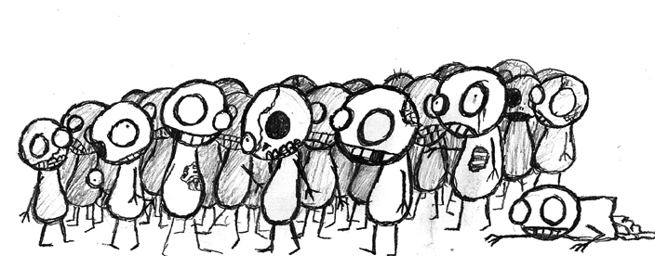
Algorithmics (HESS)
SAT 1 (semester 1)
Approximately 4 folio tasks
2 x normal, straight-forward tests
A documented project on the production and analysis of a data model
A documented project on the production and analysis of an algorithm that acts on the data model

Slide 7
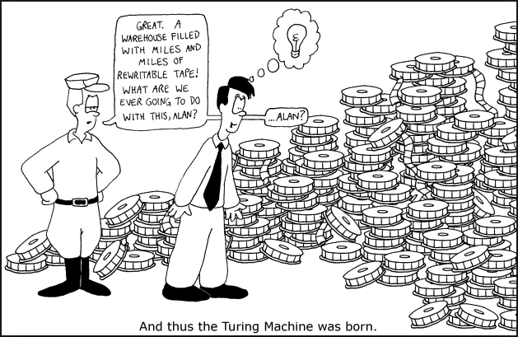
Algorithmics (HESS)
SAT 2 (semester 2)
An analysis of a given naive algorithm (written by your teachers)
An improvement to a given naive algorithm (improved by you)
2 x normal straight-forward tests
A poster task on the Universality of
Computation
Semester 2 is basically a lot more
straight-forward in terms of assessment
and is more like a series of related tests.

Slide 8

Algorithmics (HESS)
Algorithmics is about problem solving.
It’s not about the solution itself so much as the approach to getting the solution or the validity or correctness of the solution which will be generated.
There will be some coding. But it’s not a coding subject and that is certainly not what the focus of the subject is about. We will be using PyNode to visualise a lot of our graphs in semester 1.

Slide 9
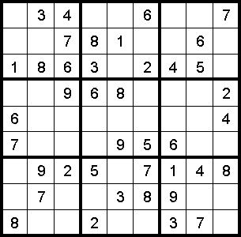
Algorithmics (HESS)
Let’s do sudoku!

Slide 10
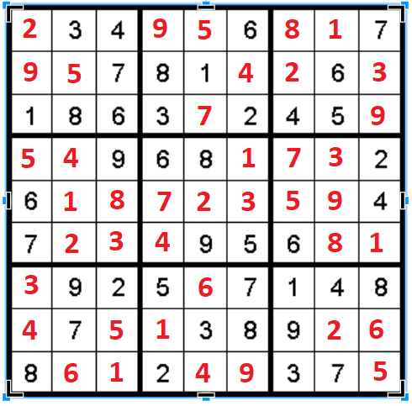
Algorithmics (HESS)
Let’s do sudoku!

Slide 11
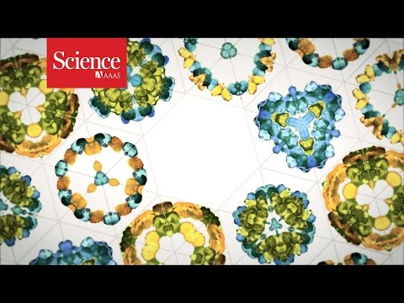
Algorithmics (HESS)
Let’s cure cancer!!

Slide 12

Reflection
How were you feeling about Algorithmics prior to today’s lesson?
Has this changed at all after today’s lesson?
What is your greatest fear about this subject?
What are you most excited about this subject?
http://bit.ly/algoform1

